Slide 1



Slide 2
Kids

Slide 3
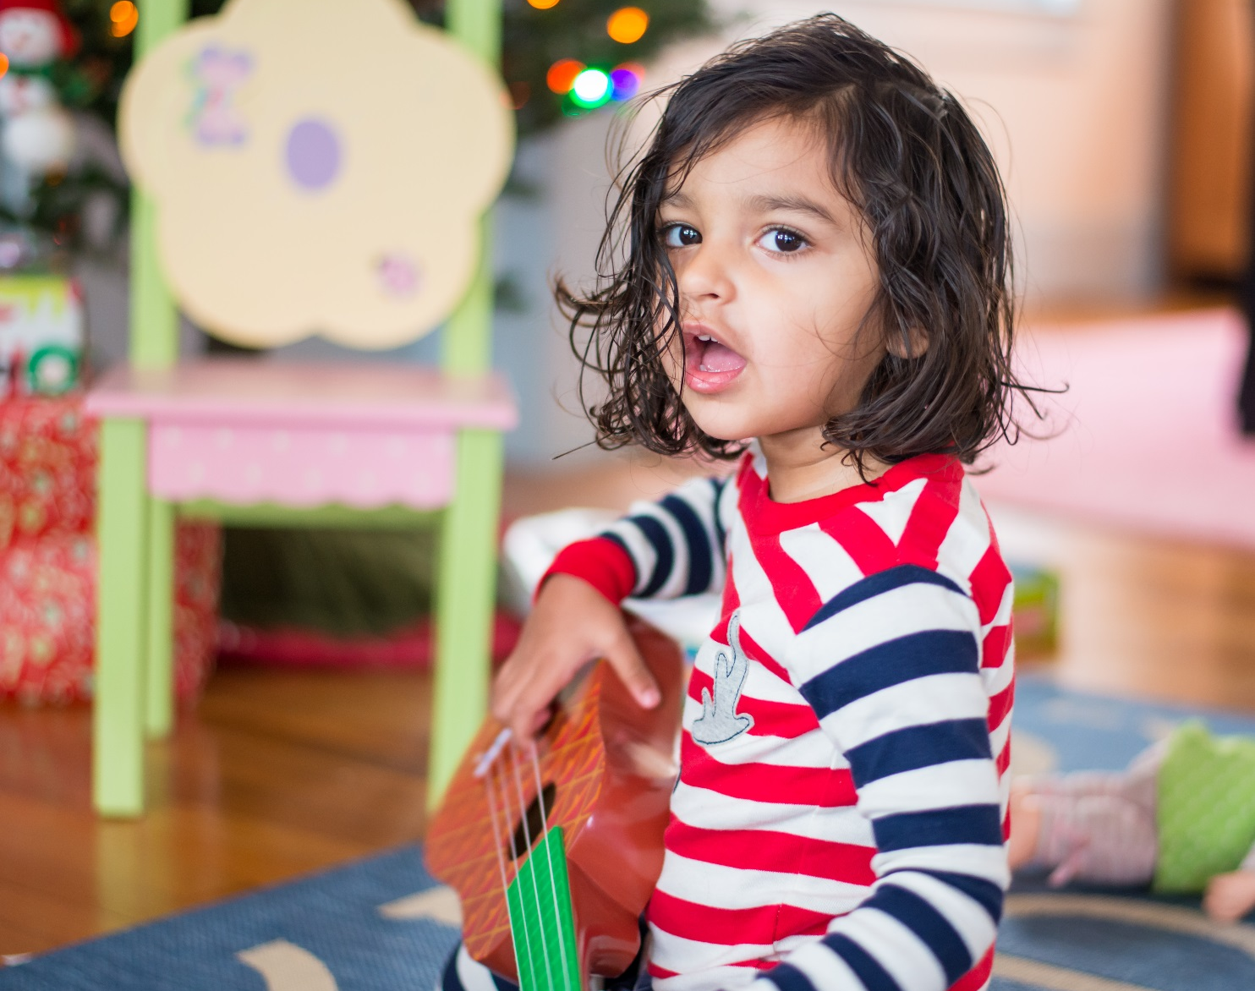
Shreya Guha
“follow my passion wildly”

Slide 4
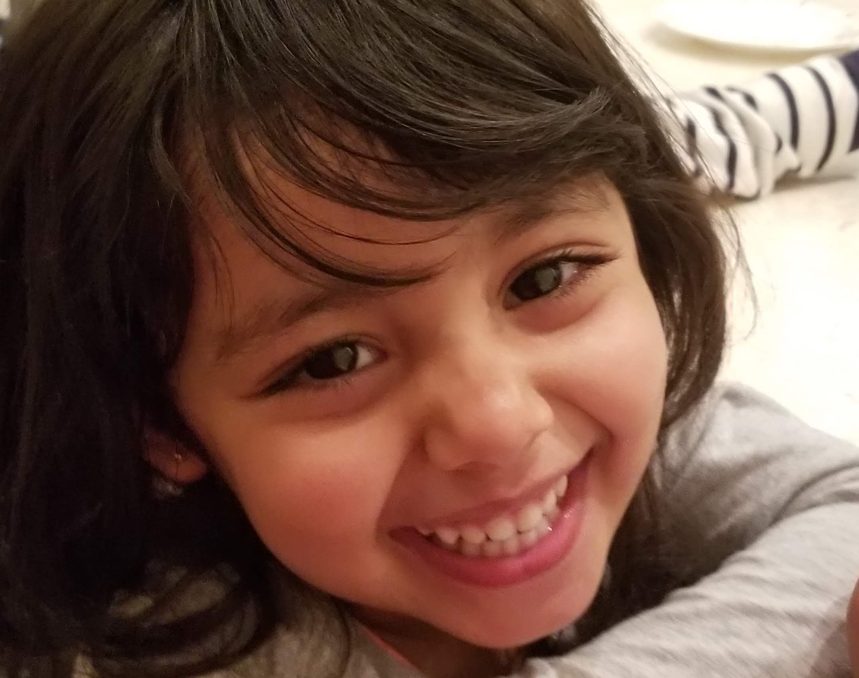
Kaushali Devi Varshney
I dream of being a dancer and doctor, both at the same time.

Slide 5
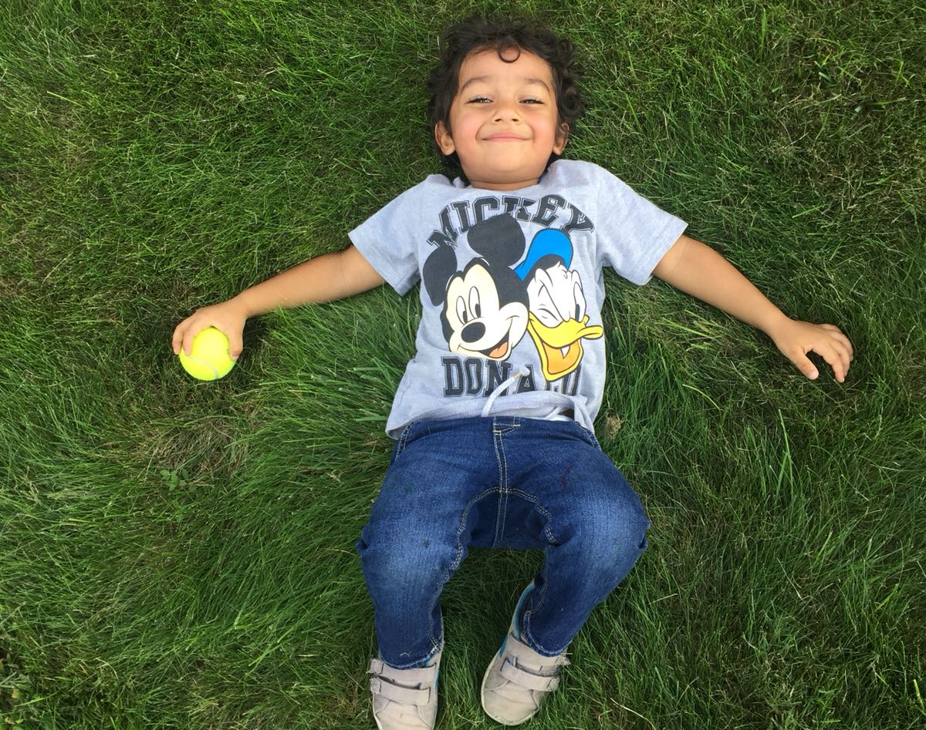
Ribhu Raj Varshney
I dream of blasting off and being an astronaut.

Slide 6
Chrysalis

Slide 7
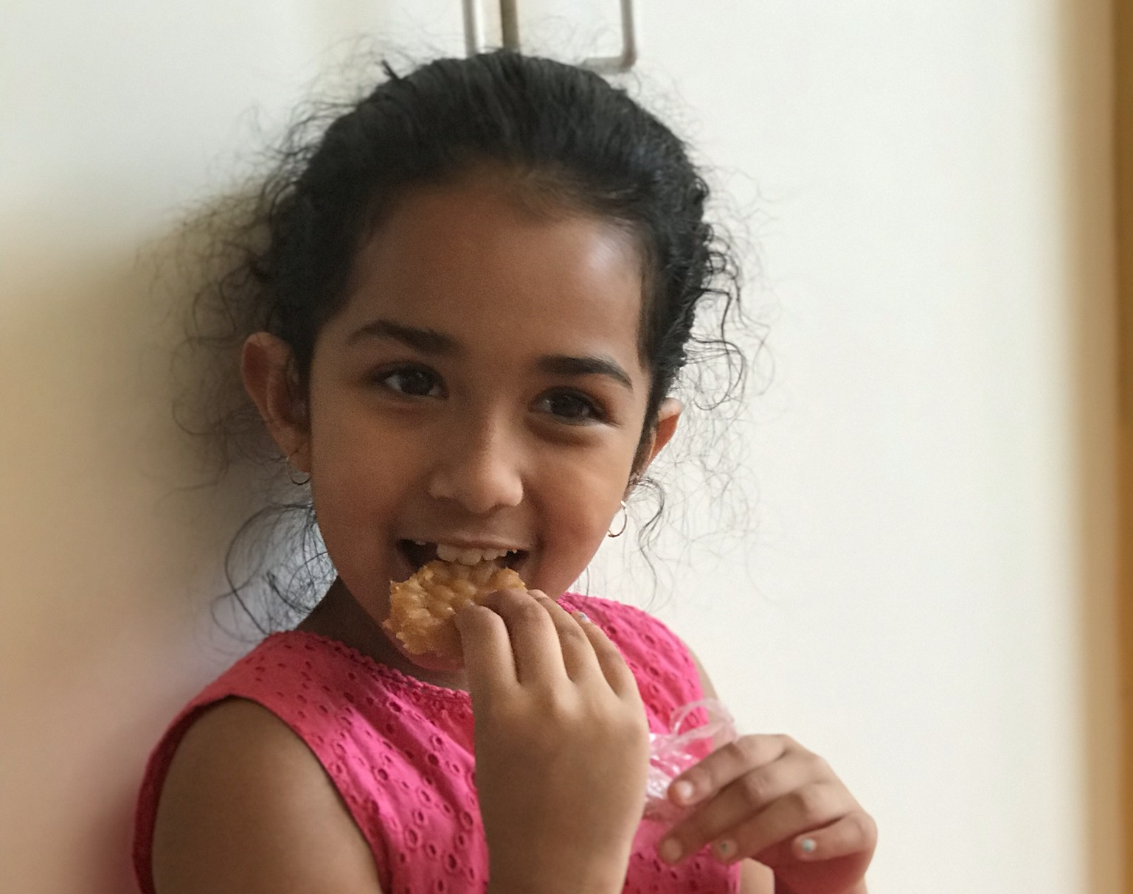
Ananya
My dreams change everyday. But most of all I dream about just playing with my dolls and legos and build things. If that doesn't work out, I can be an artist or architect.

Slide 8
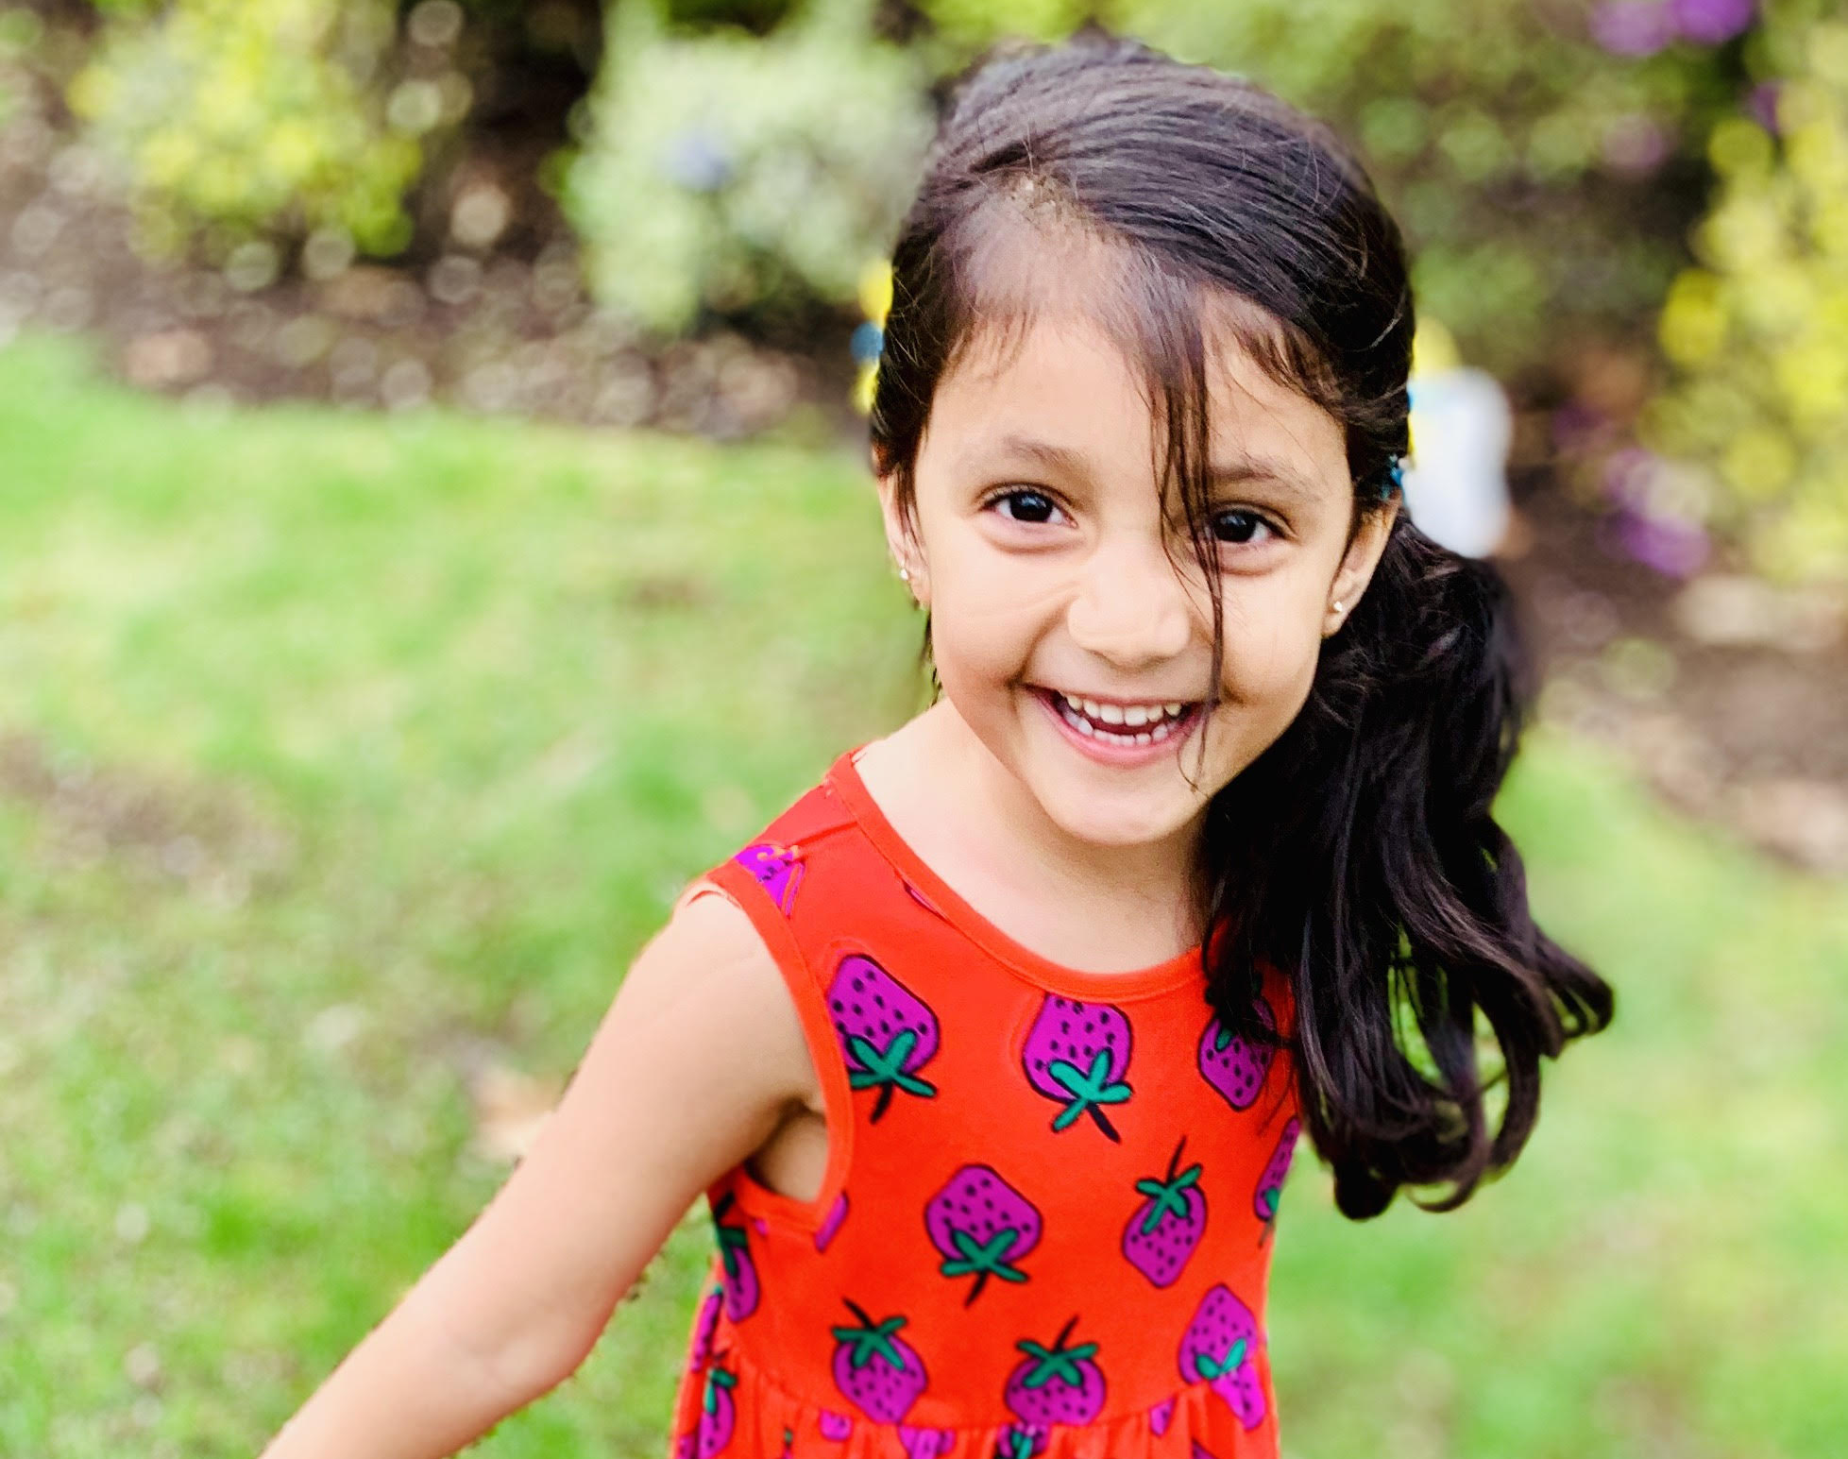
Anoushka Gupta
“I dream of being a scientist, an artist, a dancer, a doctor, a pianist, a teacher.......all this and also the President of United States of America!
I dream of turning my dreams into reality!!”

Slide 9
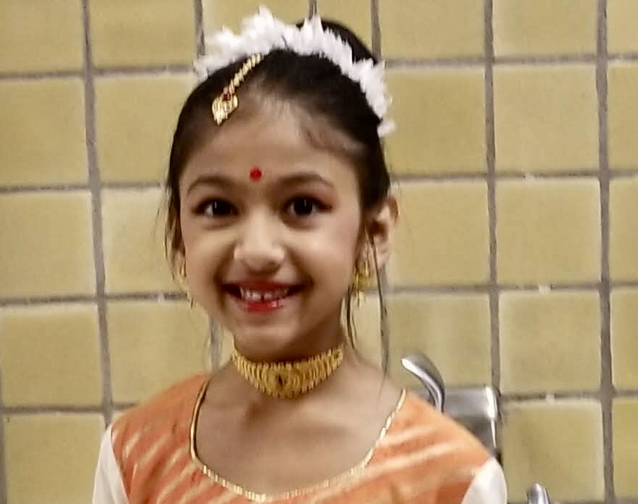
Rishika Indu Saha
My name is Rishika Saha. My favorite colors are pink, gold and teal. I like doing math. I enjoy kathak, music and arts and crafts. I want to be a bone doctor when I grow up. I like getting my nails done. I love reading books and eating ice cream!

Slide 10
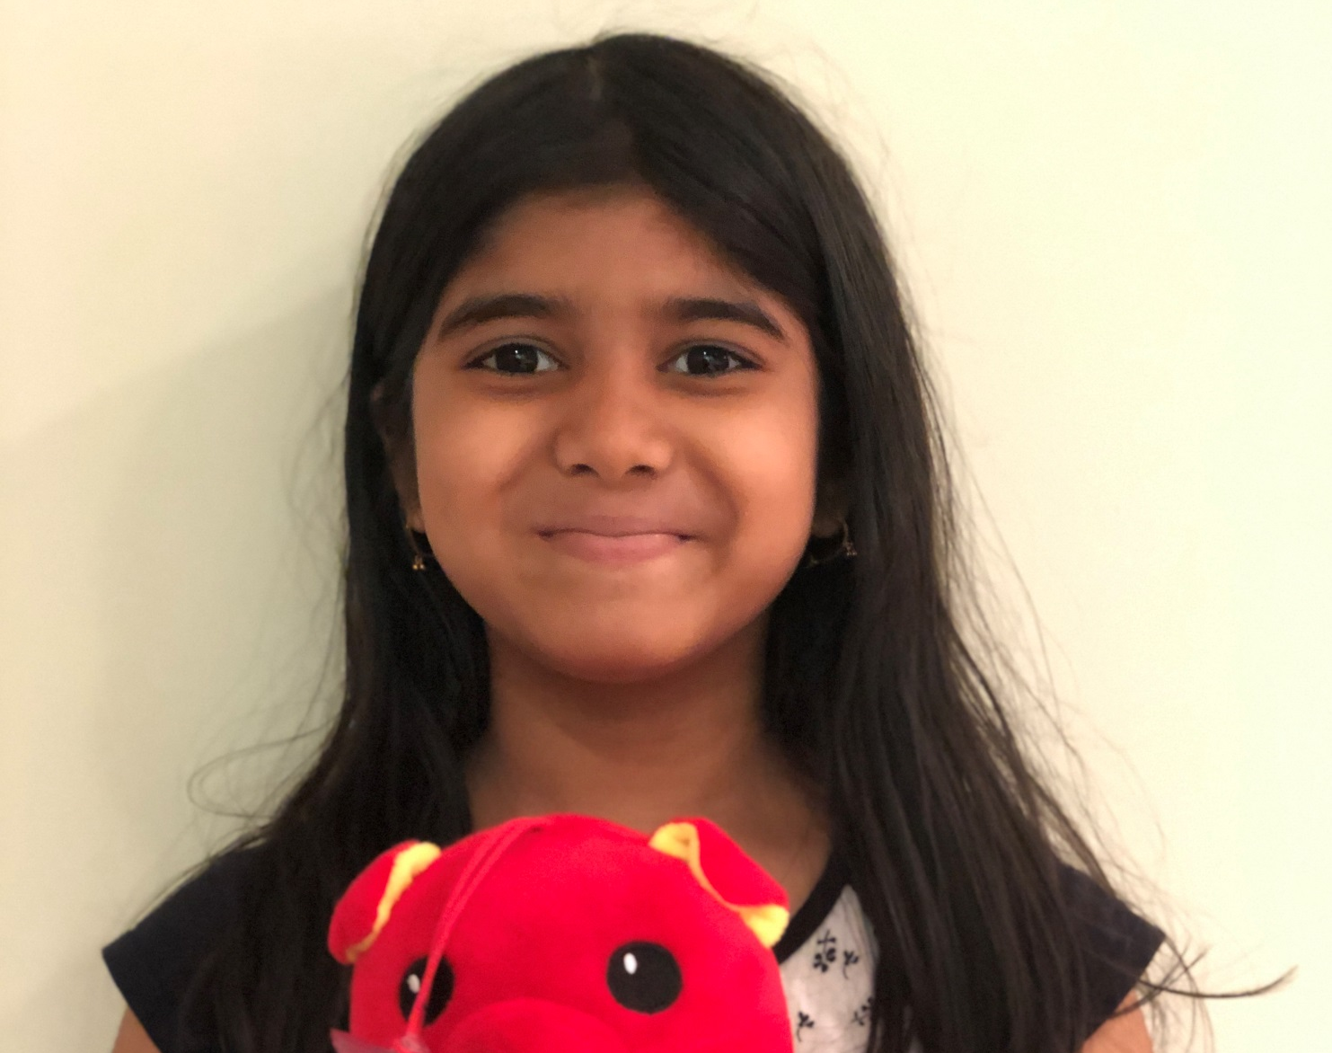
Nikita Vajpayee
I want to be a singer because I can get famous and I can express my voice. I can be on TV and it is very fun to sing as well. I’ve always wanted to be in America’s Got Talent (singing competition)! I like singing a lot, and I like humming too

Slide 11
Butterflies

Slide 12
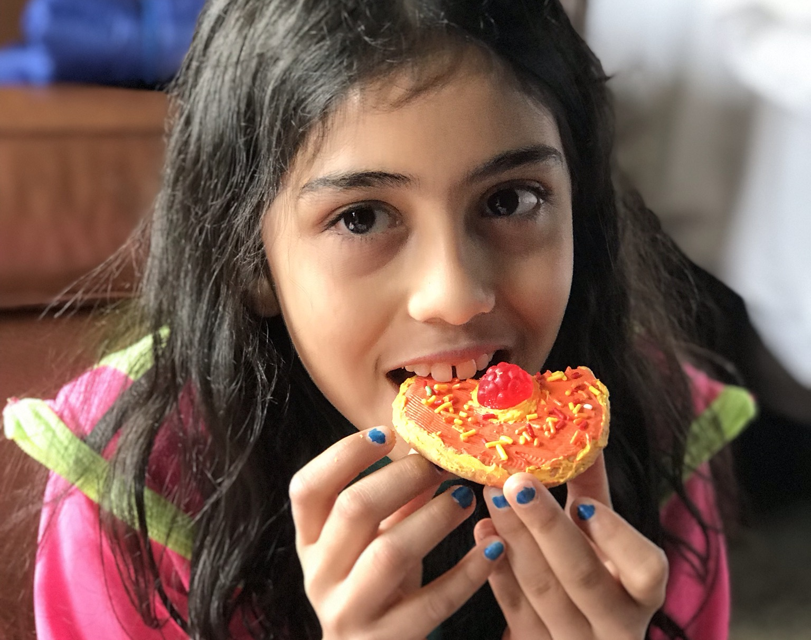
Aarushi
I dream of becoming a movie actress and a pastry chef. A movie actress because I like to act and get into various costumes. A pastry chef because I like making desserts and decorating them to look sophisticated.

Slide 13
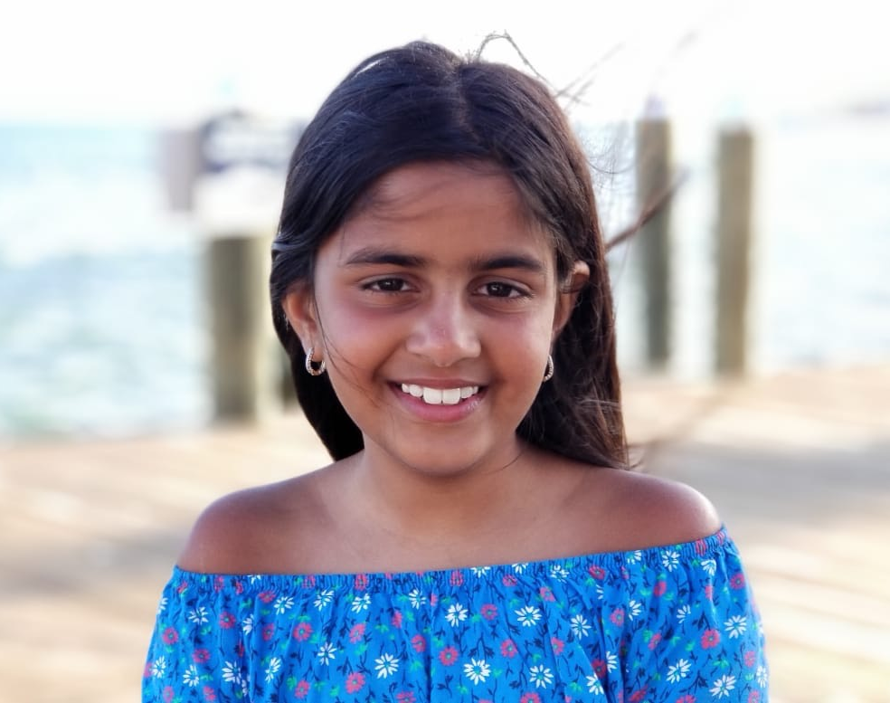
Yana Chopra
My Dream is to go to Harvard when I grow up and to become a Doctor like my Daddy .I want to go to Harvard because I want to get good education and ever since I was small that’s been my dream . When I see kids getting selected Into their dream collage I wish my dream also comes true !

Slide 14
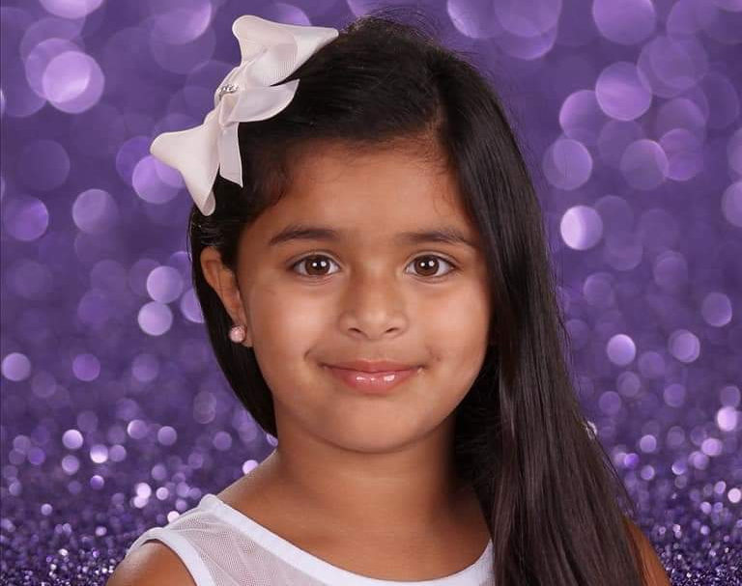
Geet Kaur Dhanoa
My name is Geet Kaur Dhanoa. I am 7 years old. I love dancing,singing,gymnastics and painting.When I grow up I want to be an art teacher. I would also like to help poor people by giving them homes to live in, food to eat, clothes to wear and most importantly help them find a job so they can have a better life!

Slide 15
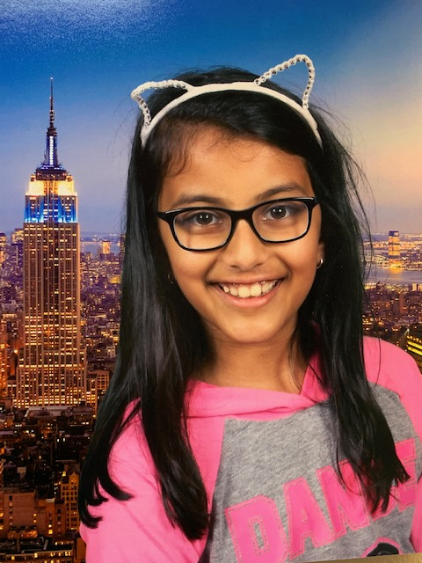
Anusha Goel
My dream is to be a computer programmer, and to spend my life working with robots. I enjoy working with numbers and learning math. Currently I am learning the coding language python, and I did a robotics club at school. I can’t wait to grow up and become a programmer.

Slide 16
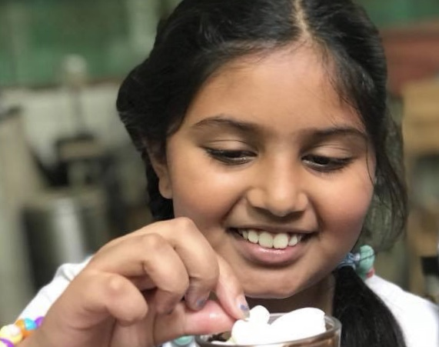
Aditi Gore
Hi my name is Aditi Gore. I love to bake delicious cakes. My dream is to start my own bakery, where I will create new delectable desserts. I really wish my dream soon comes true. Apart from baking I love to dance, sing, swim and paint. Thank you!

Slide 17
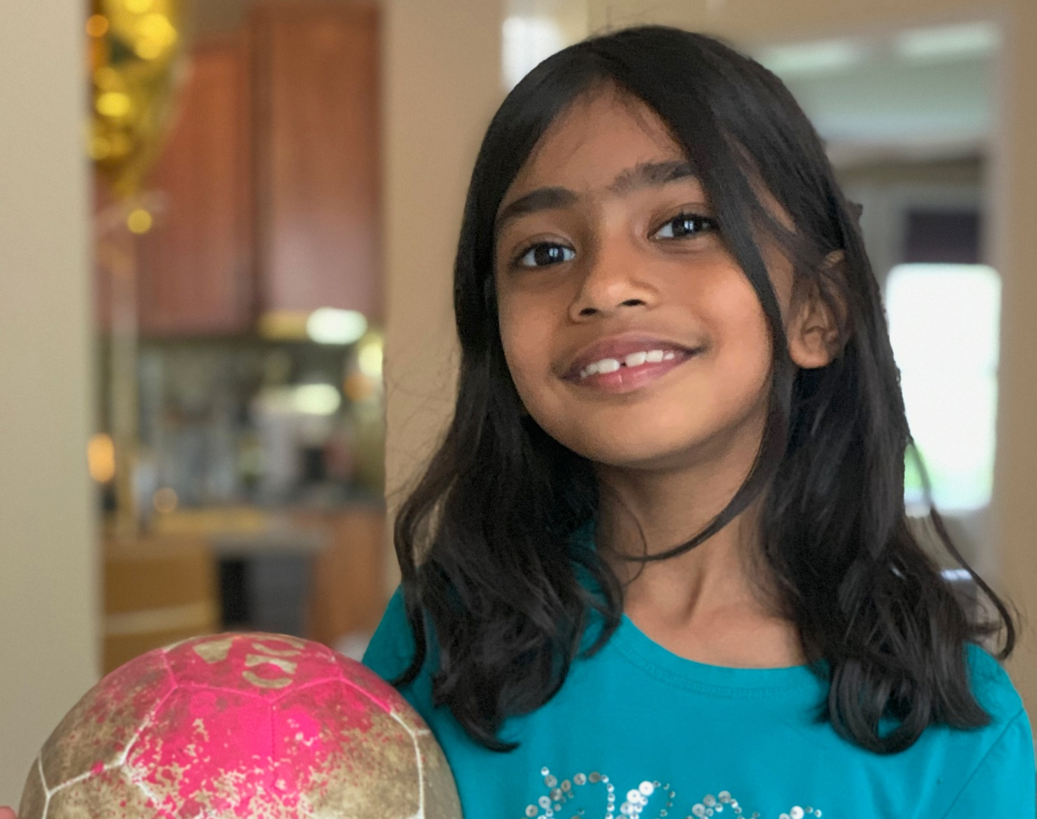
Amiya Kothari
My name is Amiya Kothari. I am 7 years old. I want to continue learning soccer. I love learning dance since it’s fun to learn new dances. I also love playing with Legos and going to S.T.E.A.M. class, so my dream is to become an engineer when I grow up.

Slide 18
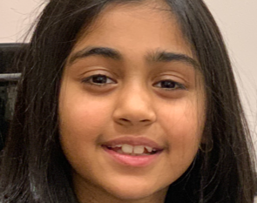
Ria Kumar
Hi! My name is Ria Kumar and my dream is to be good at sports. This includes soccer and basketball. Also I would love to be a great artist and a beautiful dancer. When I grow up - I want to be a doctor like my Dadu and eat healthy food.

Slide 19
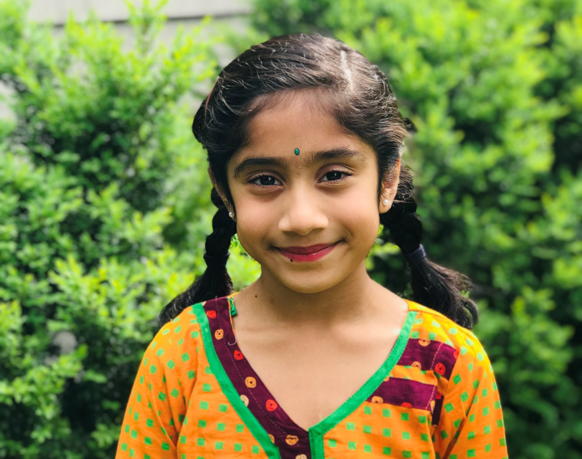
Saanvi Patel
“When I grow up I want to be a professional artist and I also want to be a famous singer and a teacher. “

Slide 20
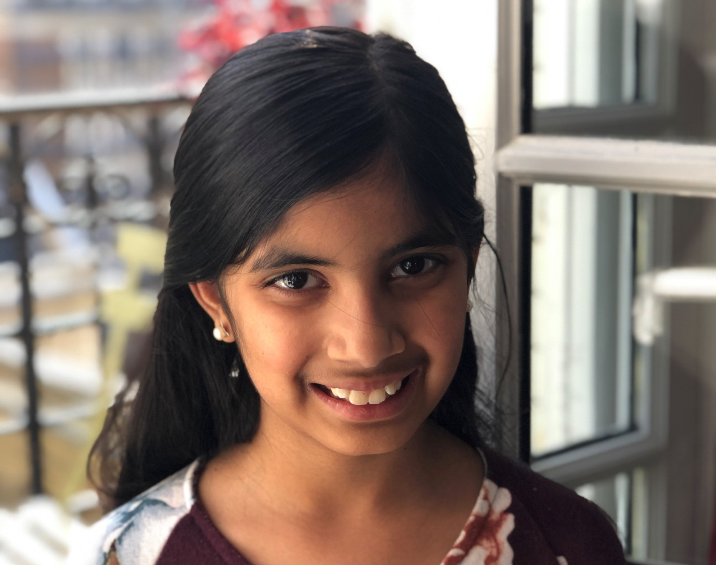
Anushri Rana
I dream of becoming an artist. It can be any kind. It can be an actress, painter, dancer etc. I dream of living in a world where women are treated equally to men. At least it is better now. I dream of becoming an artist and expressing my true self.

Slide 21
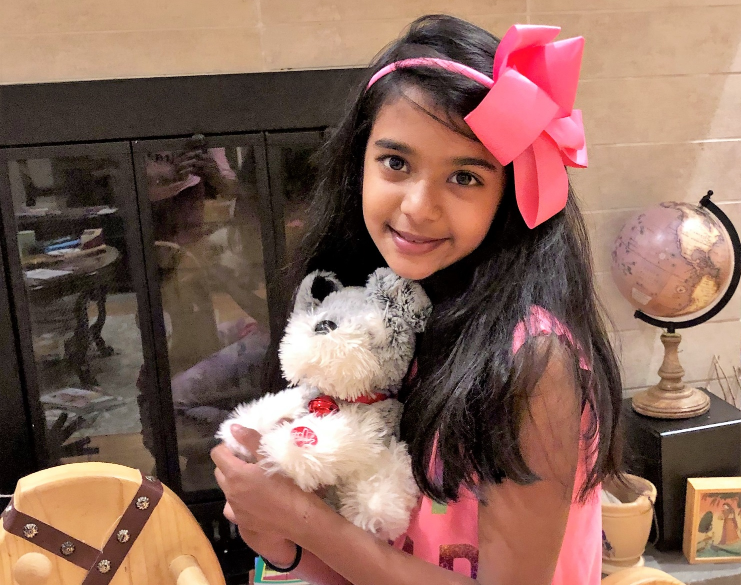
Nivriti Thakur
My dream is to become a famous actress and an inventor and bring families together. I also want to sing on my own in movies. I want to invent a washing machine that can wash any kind of animal. I want to bring orphans to families who want a kid. This is my dream!

Slide 22
Gopis

Slide 23
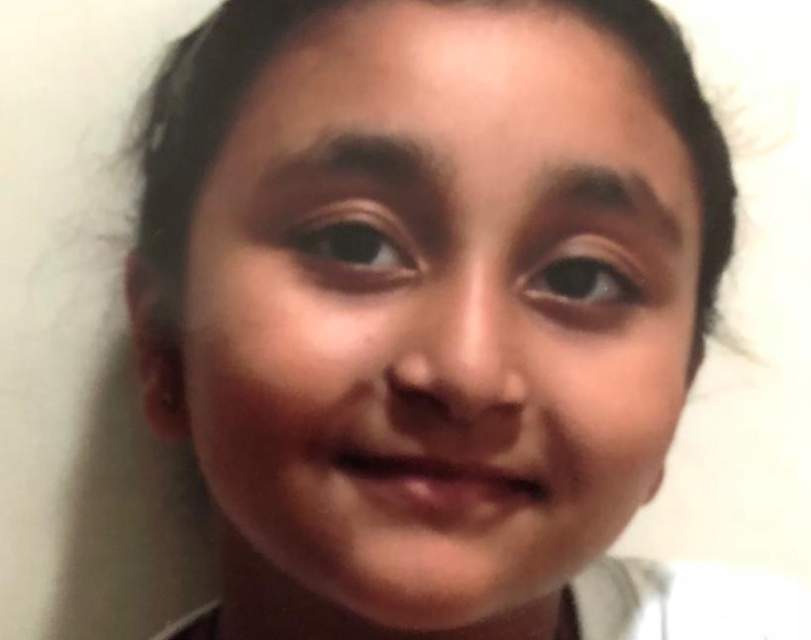
Ananya Dhanawade
I don’t have a realistic dream since as long as I can remember, everything I dreamed of was magic schools, princesses, and fair, just heroes and vigilantes saving their cities and nations. I’d love for all that to be true, so I guess that’s my dream, but it’ll never happen, so I guess world peace would be nice.

Slide 24
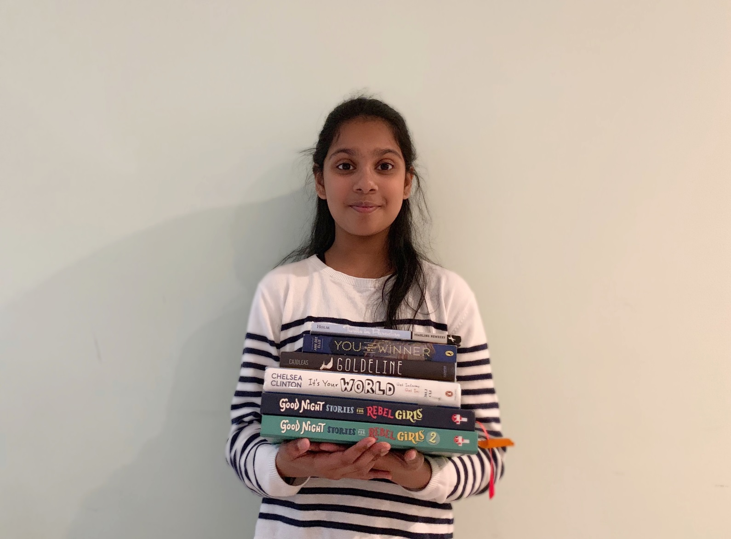
Svara Gawde
In the future, I want to make a difference in the world we live in! I am inspired by amazing women such as Malala Yousufzai, Ada Lovelace and Margaret Hamilton. I want to be educated and work hard to reach great heights. I want to help the less fortunate and make the world a better place.

Slide 25
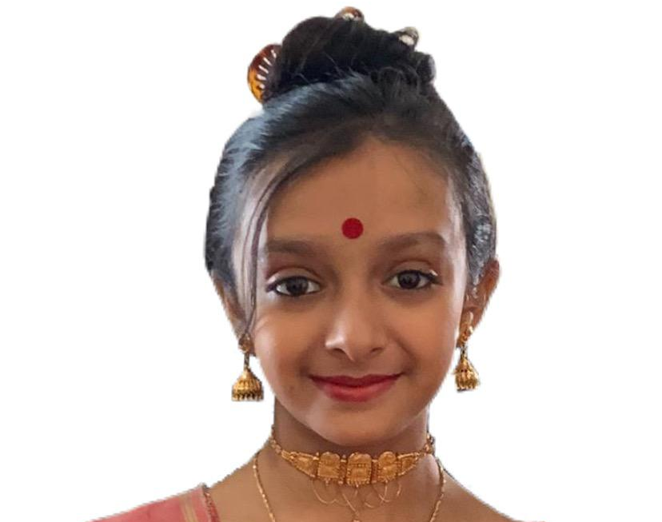
Songita Ghosh
In the future, I want to make a difference in the world we live in! I am inspired by amazing women such as Malala Yousufzai, Ada Lovelace and Margaret Hamilton. I want to be educated and work hard to reach great heights. I want to help the less fortunate and make the world a better place.

Slide 26
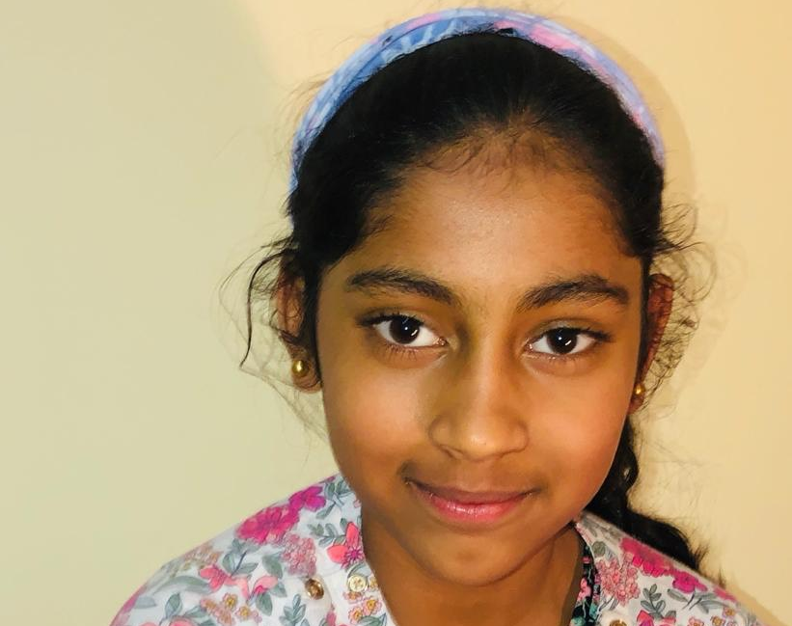
Anaya Venkata Girish
My dream is to become a gymnast. Watching people doing amazing tricks always fascinates me. Gymnastics is a sport that I have passion for. Gymnastics has a variety of tricks from cartwheels to flips. As I grew older so did my love for gymnastics.

Slide 27
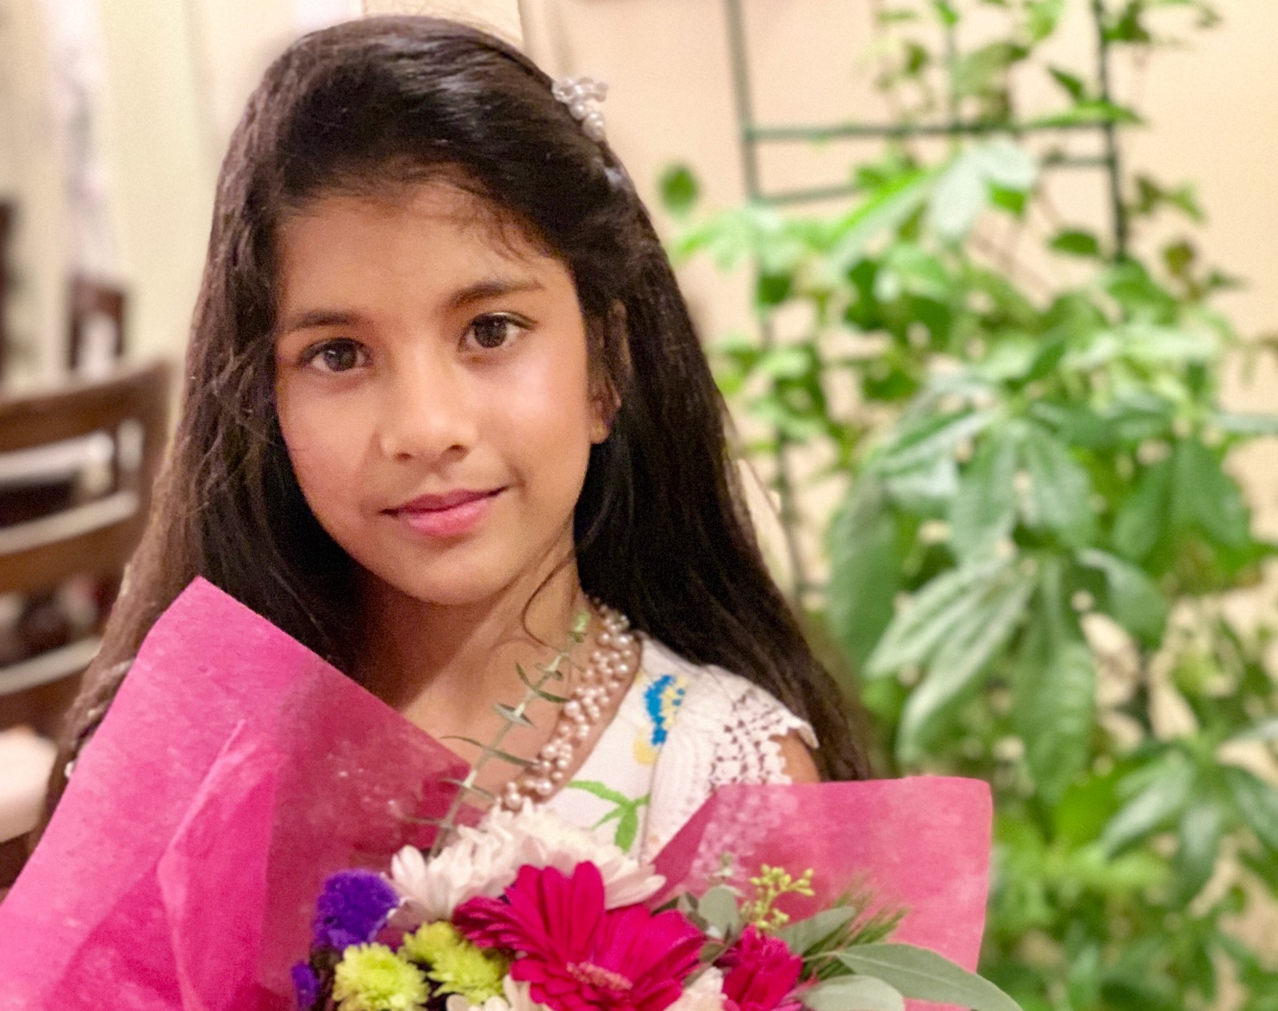
Devaki Inamdar
My dream is to grow up as a trustworthy person who adds sparkle of happiness to each and everyone around me!! My dream is to continue my journey towards excelling in dance as I see this as an embodiment of true happiness

Slide 28
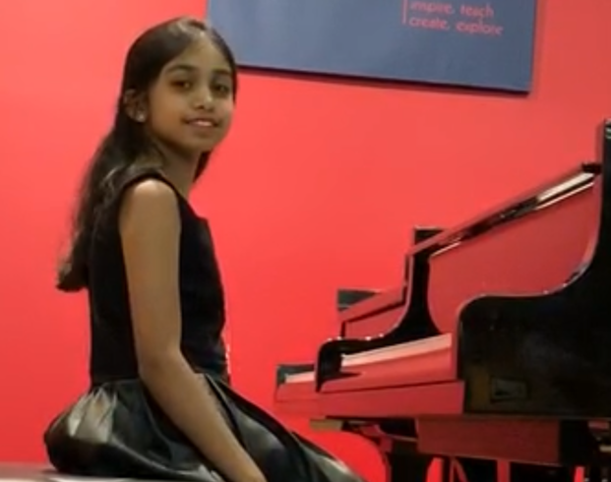
Kunjal Kothari
My name is Kunjal Kothari and I’m 13 years old. I love learning Kathak and the piano. I want to continue these two things even when I grow up. My dream is to become a doctor one day, so I can help people around the world feel and become better.

Slide 29
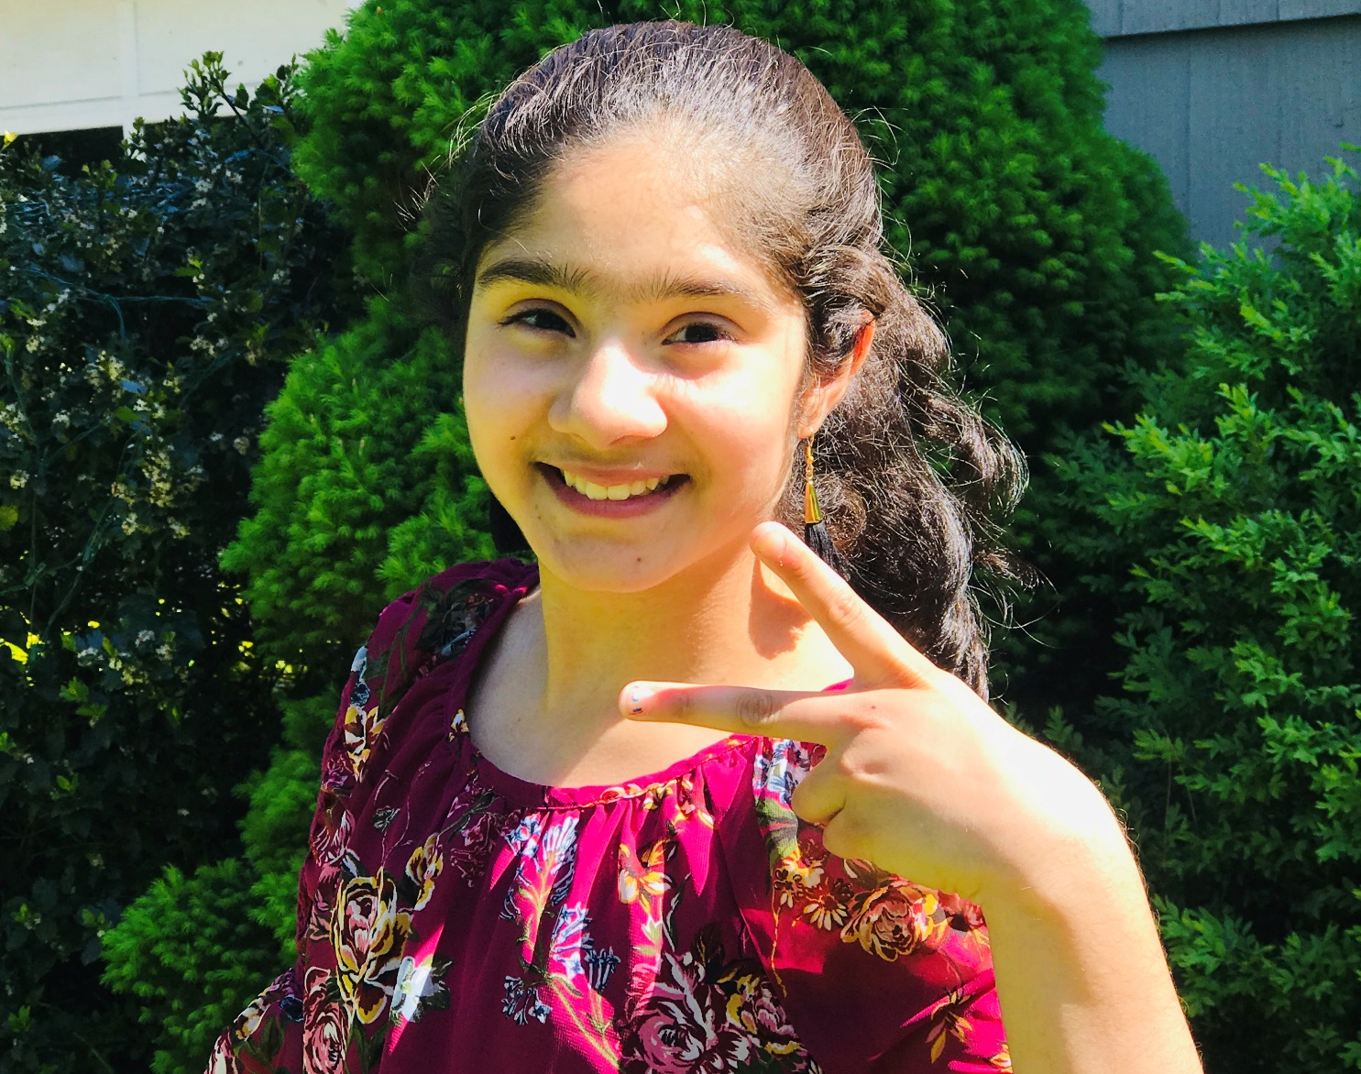
Saanjh Patel
“My dream is to be an interior designer. When I grow up I want to live in a big house with a pool and balcony. I want to go far in life. I want to make my parents proud and I also want to be an amazing dancer. “

Slide 30
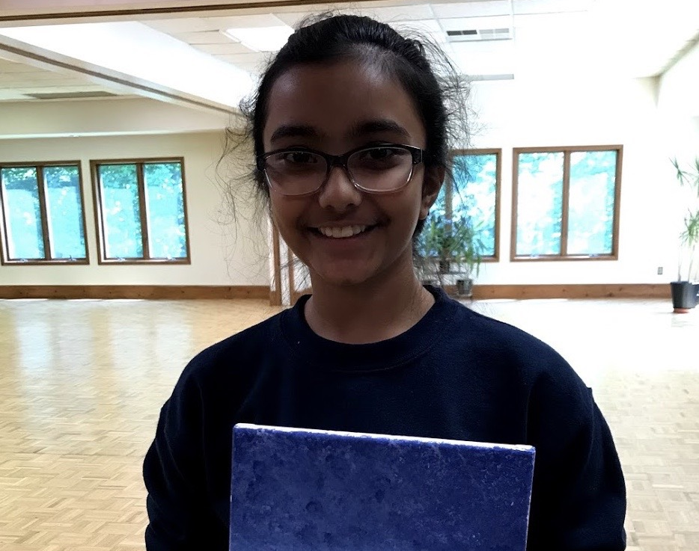
Rhea Sadarangani
Rhea Sadarangani is an amazing 12 year old young girl who dreams of being her best self at all times. She has many goals and aspirations and wishes to pursue them through working hard and getting into a good college. More than anything she dreams of being a kind, successful woman who will help make this world a better place.

Slide 31
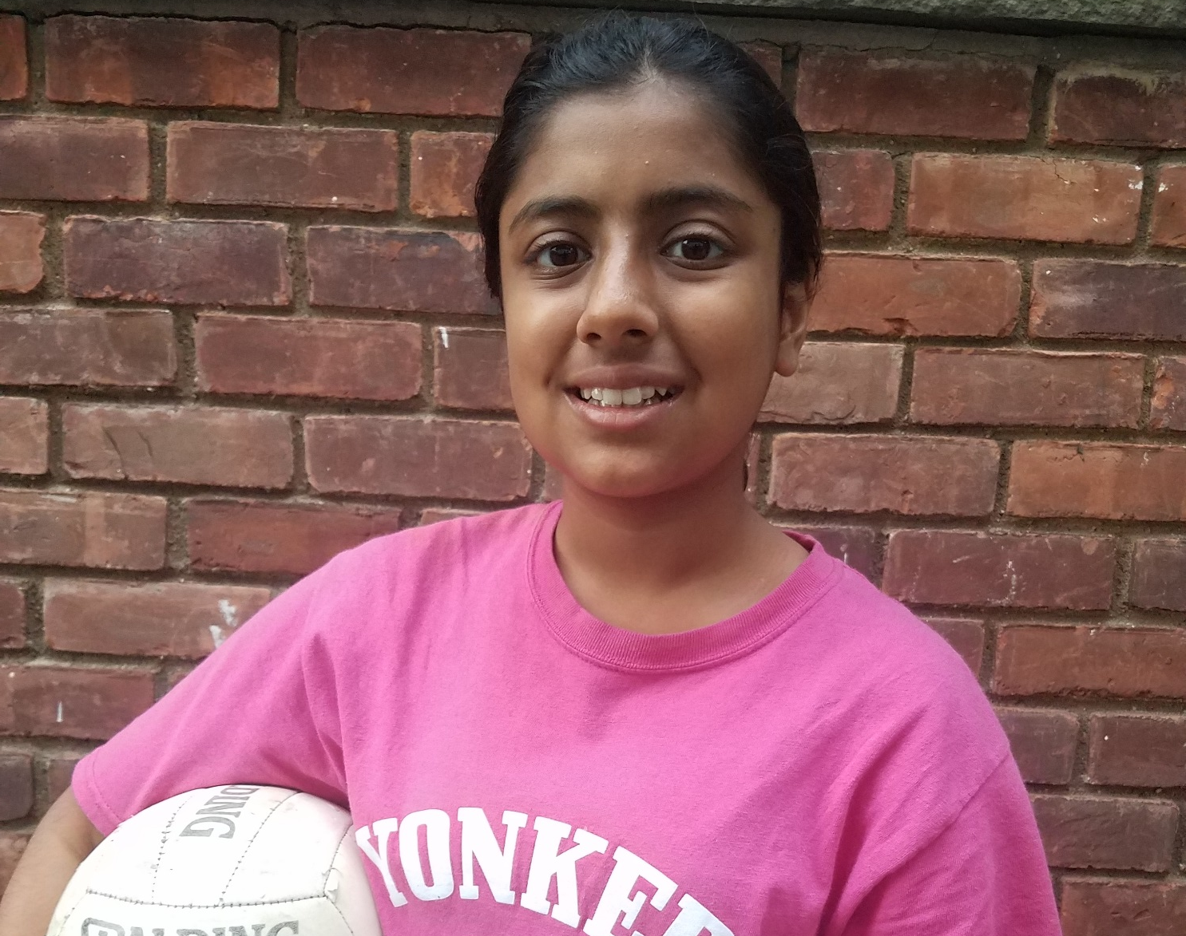
Surbhi Singhal
Surbhi Singhal is an outgoing girl who hopes to one day become a neurosurgeon. She enjoys dancing and playing volleyball. In her free time, Surbhi loves to ride her bike and devours books. In addition, she loves camping and hiking, and would never turn down an opportunity to explore nature!

Slide 32
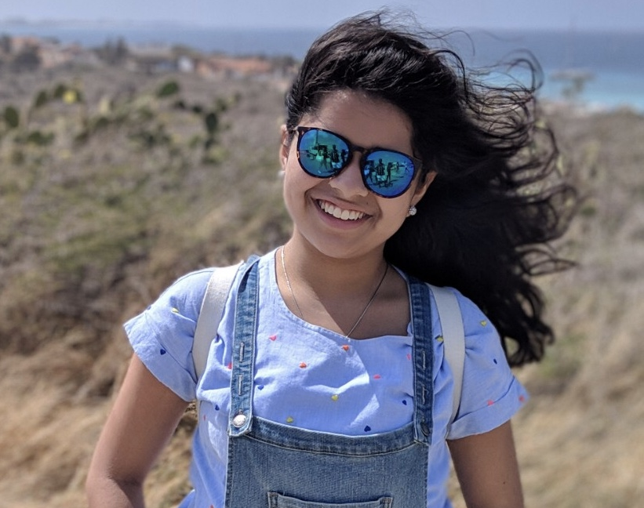
Zaara Suhail
I have been learning Kathak for almost 7 years. I have continued to dance for so long because dancing puts me in a happy place. I taught myself how to sew when I was little. This made me realize how interested I was in sewing. After that I started making dresses for dolls. I hope this will help me pursue my dream in becoming a popular designer.

Slide 33
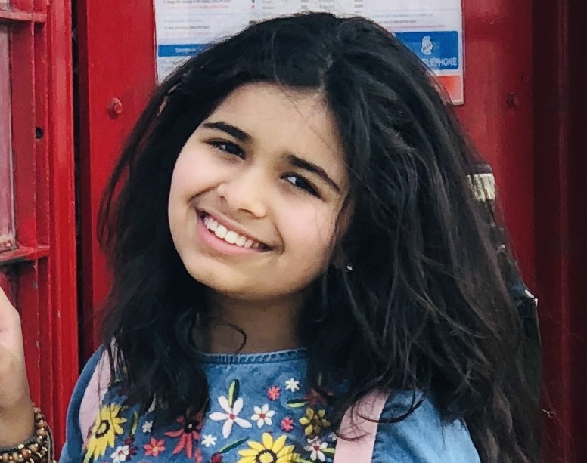
Zoeya Suhail
My dream is to travel around the world. I have been fascinated by many places around the world. I dream of visiting these places one day. Places in Europe and South America have always intrigued me. Hopefully, one day, I'll have a large collection of souvenirs from around the world.

Slide 34
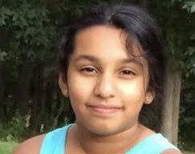
Mugdha Wadekar
My dreams and aspirations for my future are to get into a good college, get to work in the field that I am passionate about, and to travel the world and see new and different places. I am not exactly sure what I want to become - maybe a scientist, but I definitely want to do what I love. I want to have a lots of friends as I want to do really fun things with them like go to Europe and see all the amazing places. I will work hard to make my dreams come true.

Slide 35
Intermediate

Slide 36
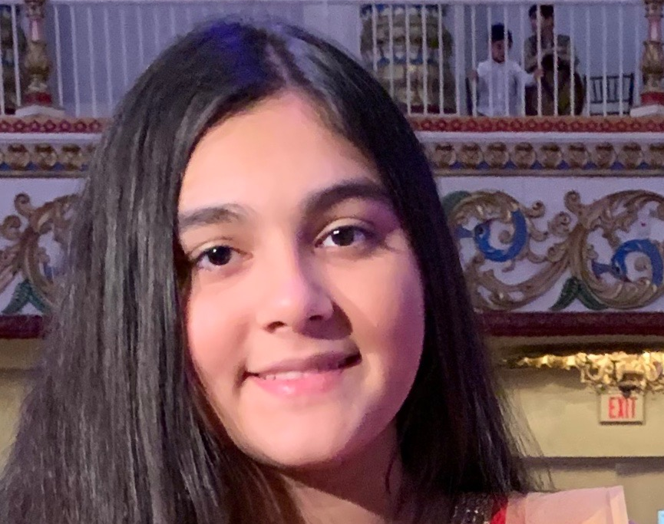
Aarna Arora
My dream is to become a lawyer. I’ve watched so many crime shows and the least acknowledged character is the lawyer but the lawyer is the one that finally brings the victim to justice. That’s what I aspire to do, to help people and bring victims to justice no matter what.

Slide 37
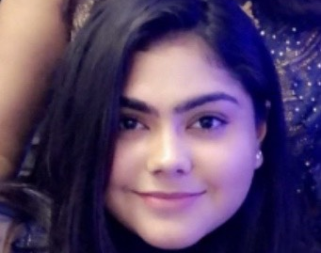
Chahat Arora
Throughout my life, my dreams have continuously changed, at one point it was to be an actress, and at another point it was to be a fairy. Currently one of my dreams is to be a doctor, but who knows, it could change again. However, one dream that has stayed constant through everything is that I want to be able to make my parents proud. My parents have given everything I have ever wanted and more, and all they wish for me is to do the best that I personally can. My dream is to do something that will not only make my parents proud, but also change the world in a positive way

Slide 38
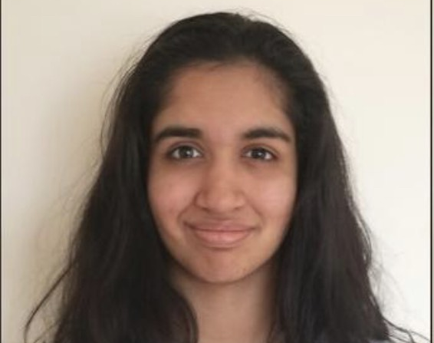
Ritika Brahmadesam
My dream is to become a financial analyst on Wall Street. I also want to travel the world and explore art and music in regions all around the world.

Slide 39
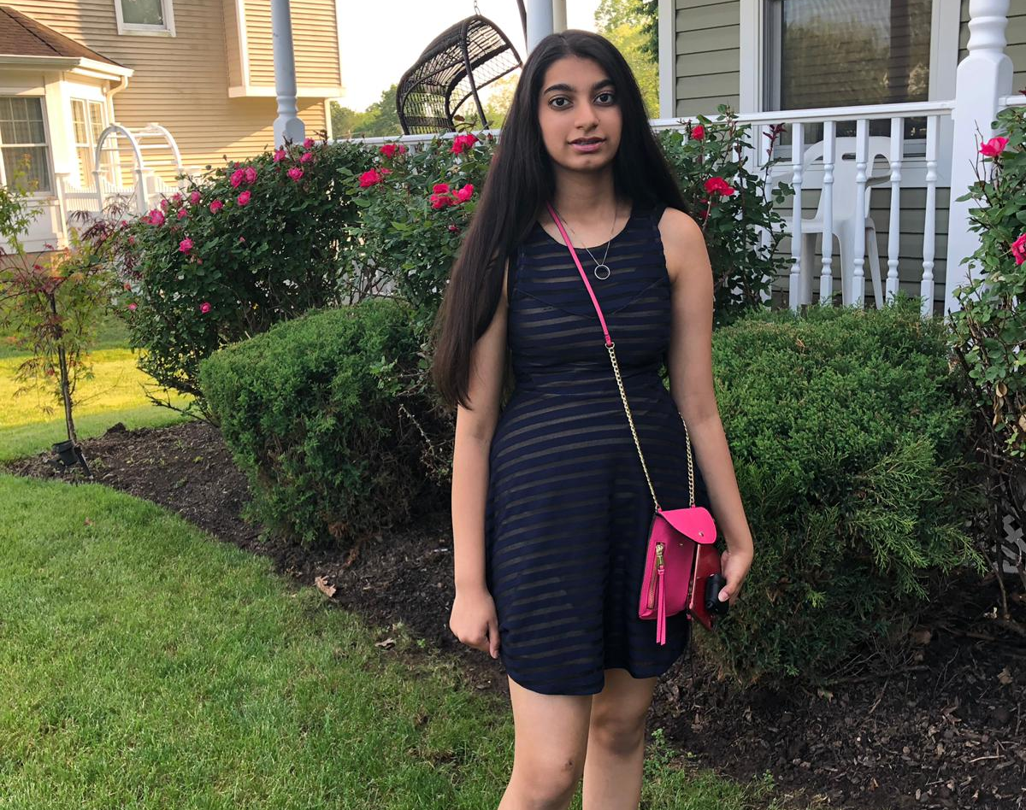
Sanya Chaudhary
I love animals, especially dogs. They are part of our family and they are also very loyal to us human beings. I get very sad when I see an animal suffering, so I want to help them feel better in any shape or form. This is why I want to be a veterinarian.

Slide 40
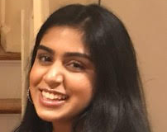
Anvi Datta
My dream has changed multiple times in my life. To become a teacher, one that works with the less fortunate, a doctor, etc. What’s common with all of those? Helping people. My dream has always been to do well in life so I can help people. I work hard everyday at school and extracurriculars so I succeed in life and fulfil my dream of helping children, the less fortunate, the sick, and more!

Slide 41
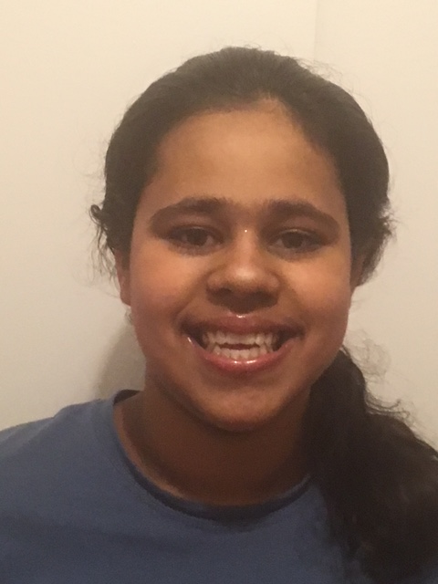
Veerika Dube
I have a dream to be a successful lawyer, and work in supreme court. Also I would like to pursue Kathak and teach it because it is enjoyable and I am able to find my inner self through dance. I am able to connect with my roots through kathak.

Slide 42
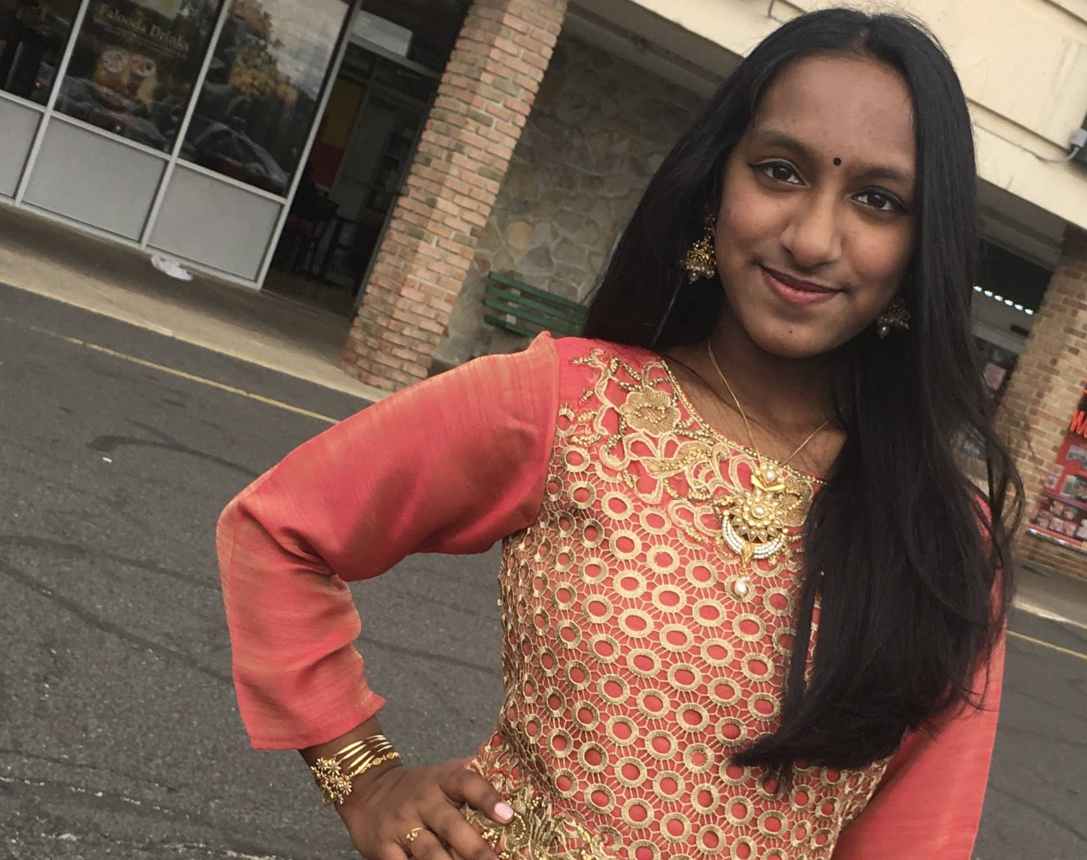
Supriya Ghosh
My name is Supriya Ghosh. My dream is to help people to the best of my ability. I dream of becoming a pediatrician one day to help children and take care of them. It will make me happy providing medical care to children, adolescents, and young adults. I want to be able to prevent and treat illnesses that children are prone to get.

Slide 43
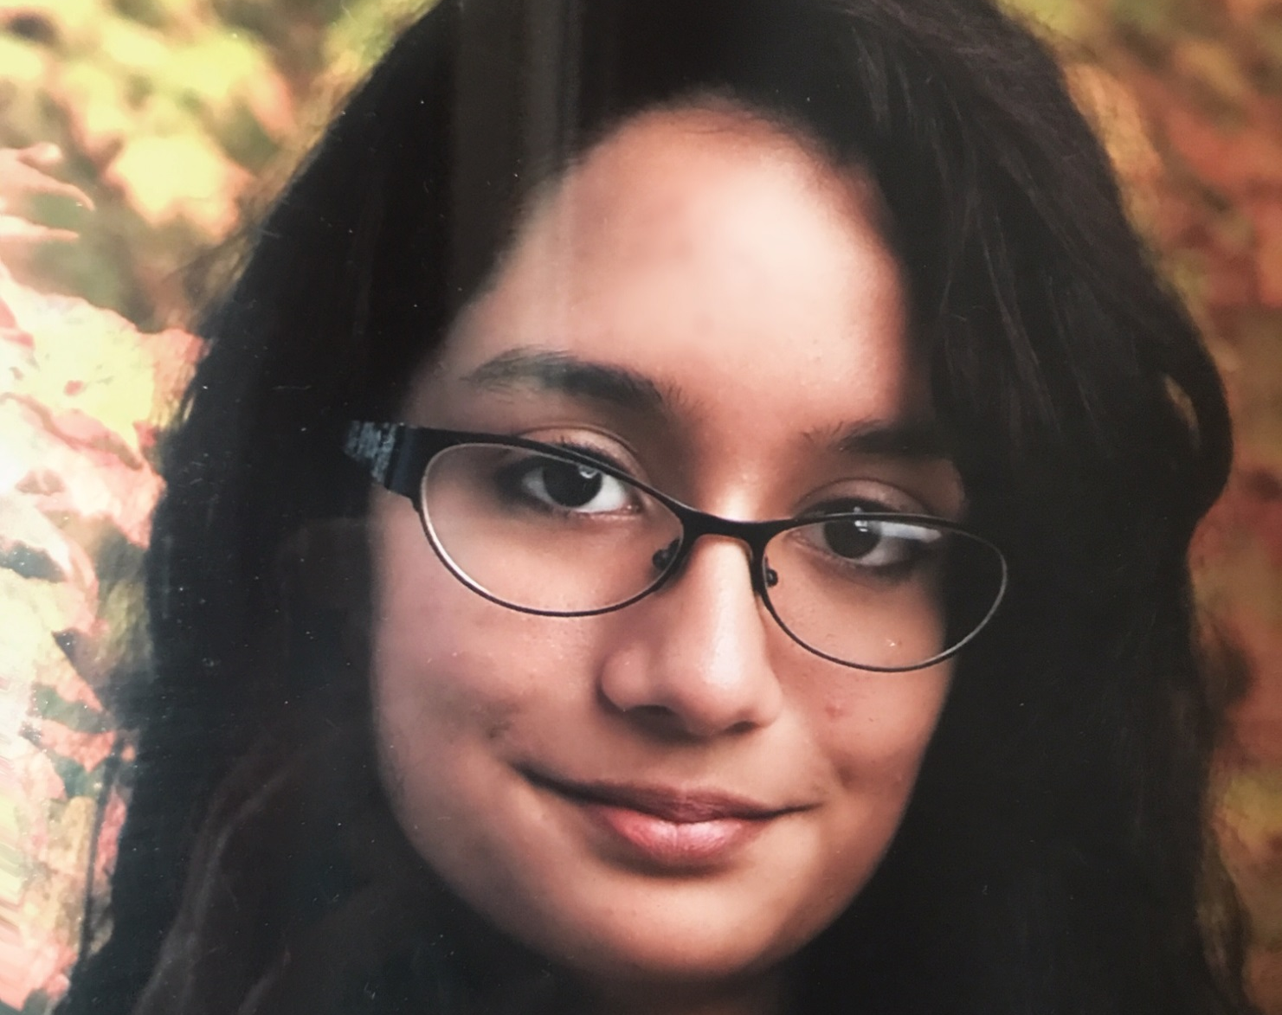
Sana Parija
Simply, I want to live happily and of my own volition. Regardless of how I get there, I hope to find my way to a place where I can look at my life and recognize that this place is where I want to be.

Slide 44
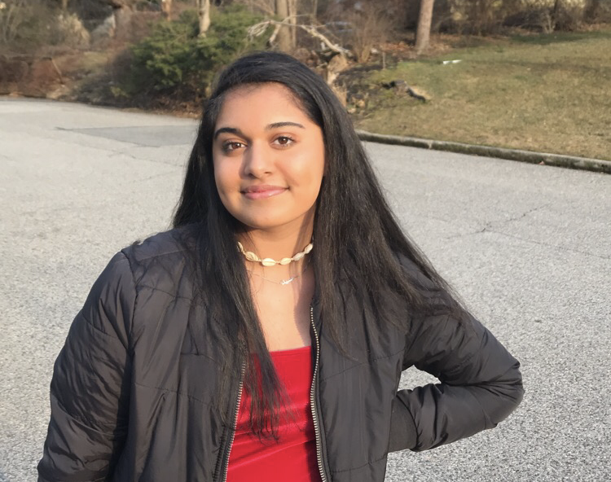
Moneesha Syed
My dream has always been to help people. Growing up around my moms job has influenced me to think about how to help others. Equality has always been something important to me and now i’m able to dance for a cause that I strongly believe in is truly amazing. Empowering women and people of color is crucial in our community.

Slide 45
Seniors

Slide 46
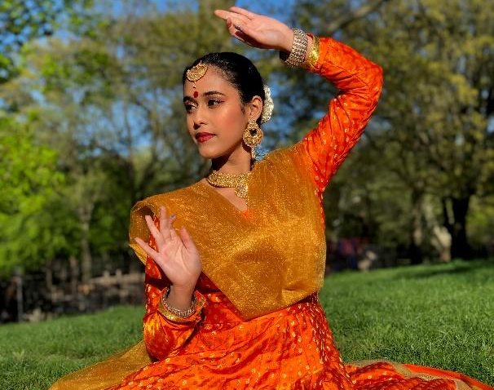
Ananya Chatterjee
My dream is to pursue my passions for dance and science while giving back to my community. I would like to develop a dance therapy program to combat neurodegenerative diseases such as Alzheimer’s disease. Additionally I dream of living my life to the fullest, traveling the world eager for new adventures and cherishing my time with my family and friends.

Slide 47
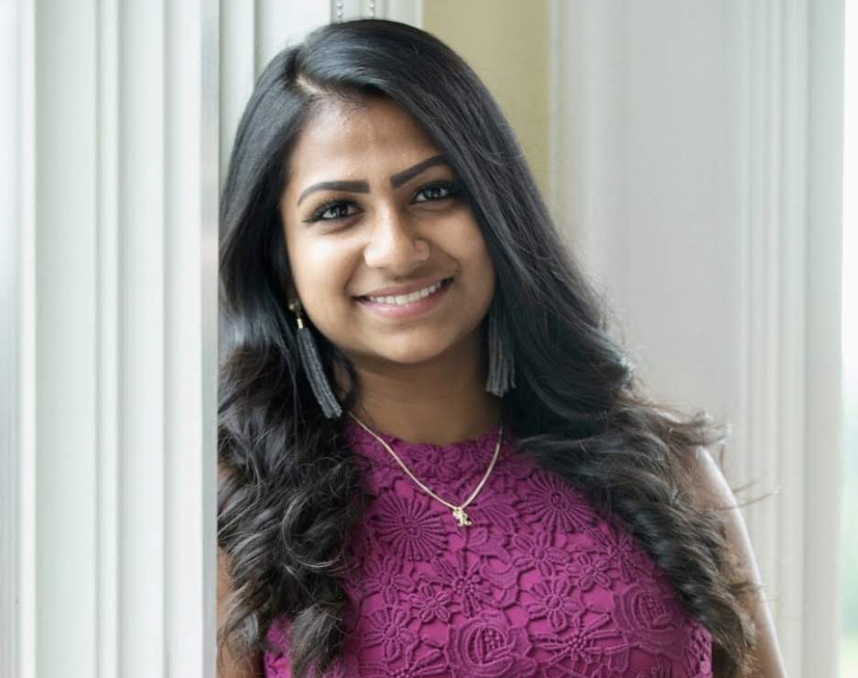
Rhea Ghosh
I am a rising sophomore at Quinnipiac University majoring in International Business. Ive been dancing with Anindita Mashi since a very young age and always found myself through dance. My dream is to travel the world and experience new cultures and through that help those who are in need.

Slide 48
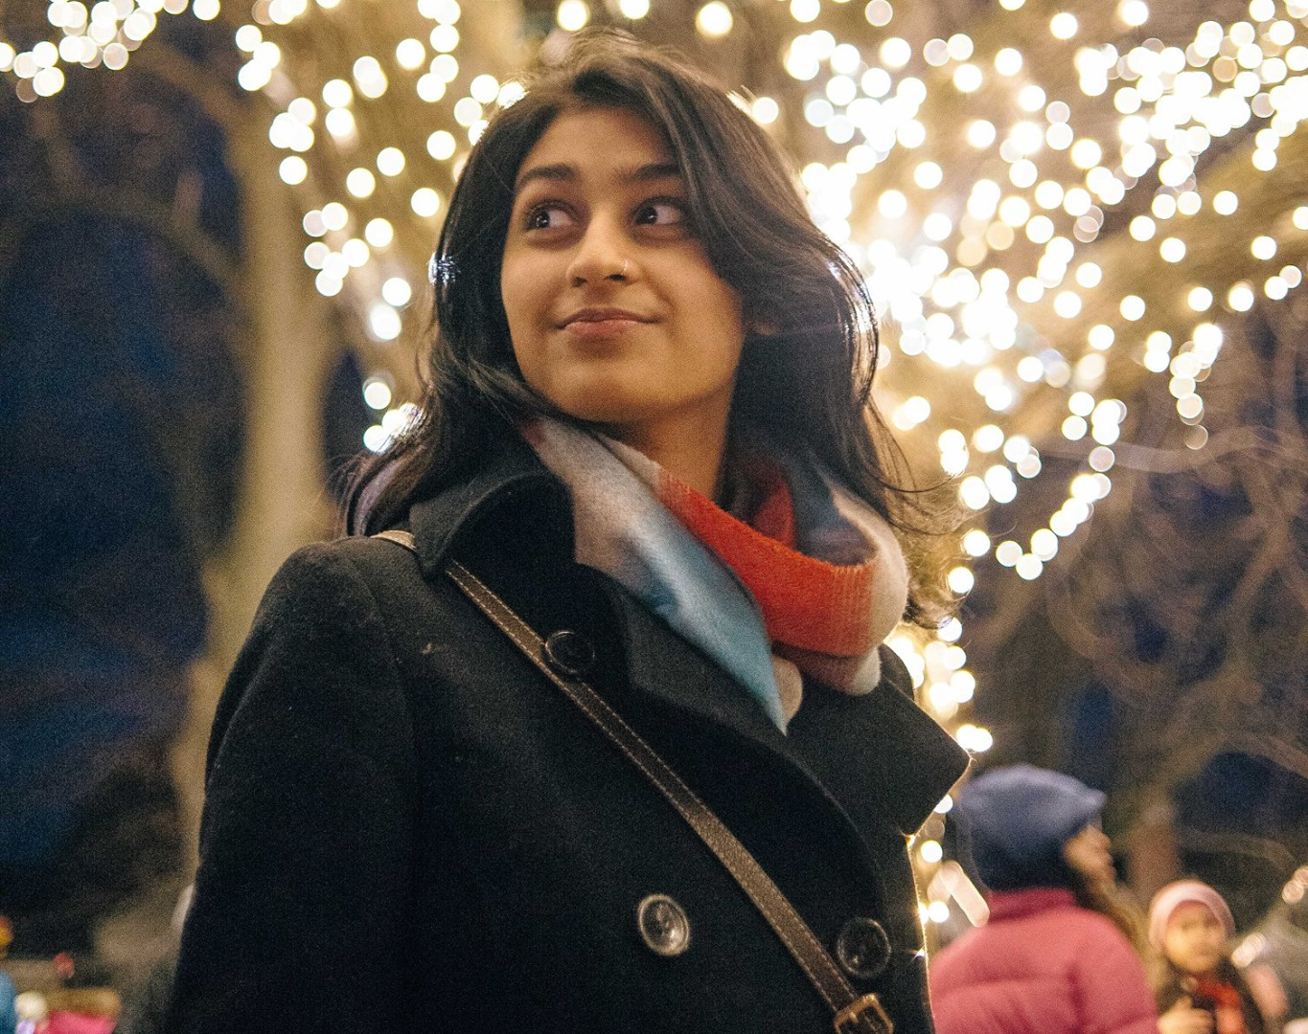
Smriti Karwa
My dream is to use my voice to empower others and to spread knowledge, care, and love to others around me.

Slide 49
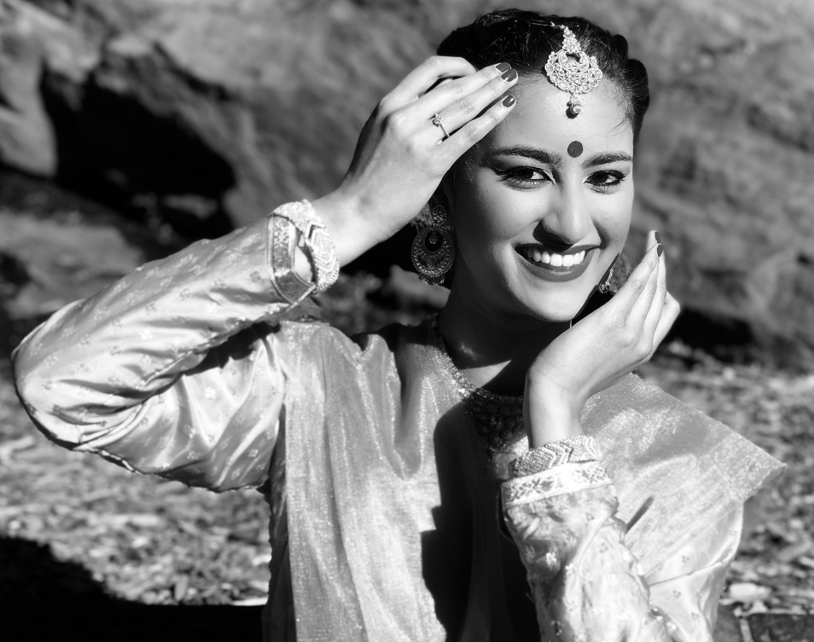
Sonali Sharma
I am a rising sophomore at NYU studying Biology, and I hope to become a surgeon in the future. As Saswati Didi and Maharajji always say, no one can ever learn everything about Kathak, no matter how long they study it for. So, in the future, I hope that I will be able to sustain not only a professional career of helping others, but to also continue embracing my passion for Kathak as a dance student.

Slide 50
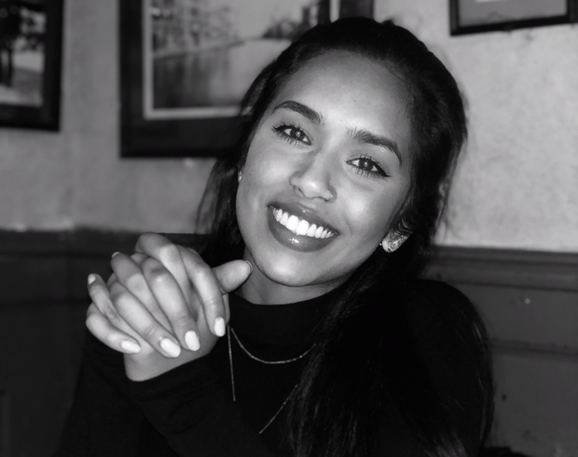
Joya Syed
My dream is to mine the potential of our cultural heritage to give hope especially to people in depths of despair. After graduation, I will be pursuing human rights activism to promote gender equity, end racial and religious discrimination and empower women through creativity in dance.

Slide 51
Creative

Slide 52
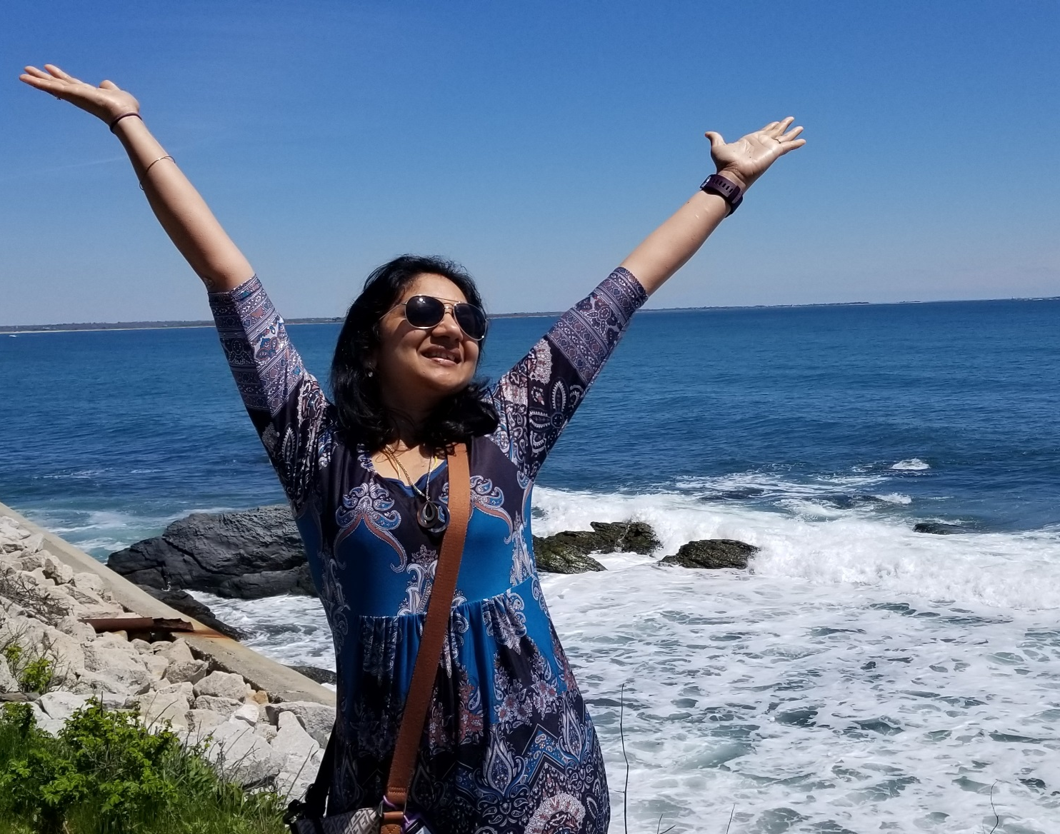
Bhavani Arvind
To be more humble amongst friends and family and try to build up others before myself; To Motivate, To Encourage, To include, To aid children/Adults with different abilities to think beyond their condition and help achieve their dreams. To experiment with asymmetric designs to try to achieve visual balance without symmetry.

Slide 53
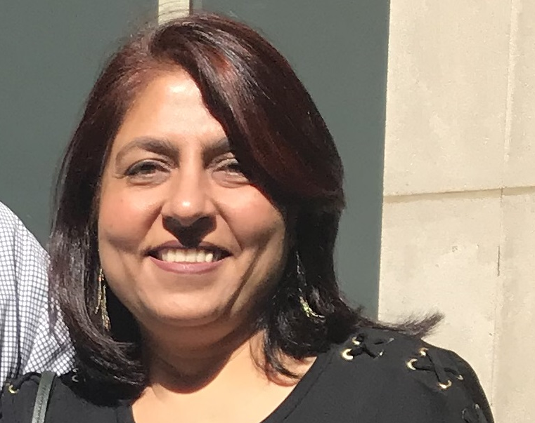
Anu Bhambri
I dream to explore my artistic and creative side and create magic. Dancing keeps me relaxed, happy, is a great source of joy and brings good health. I want to be so good at it that it flows smoothly, and I feel proud of myself to achieve that level .

Slide 54
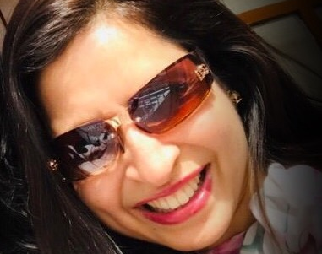
Monika Bhatt
I am living a dream life in fearlessly pursuing my passions and supporting causes I believe in!

Slide 55
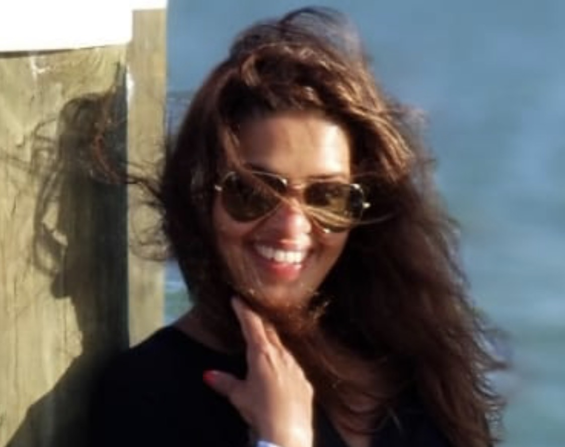
Seema Chopra
Growing up the only Dream I had was to become a cabin crew and I achieved my dreams . So Believe in yourself and go after your dreams!

Slide 56
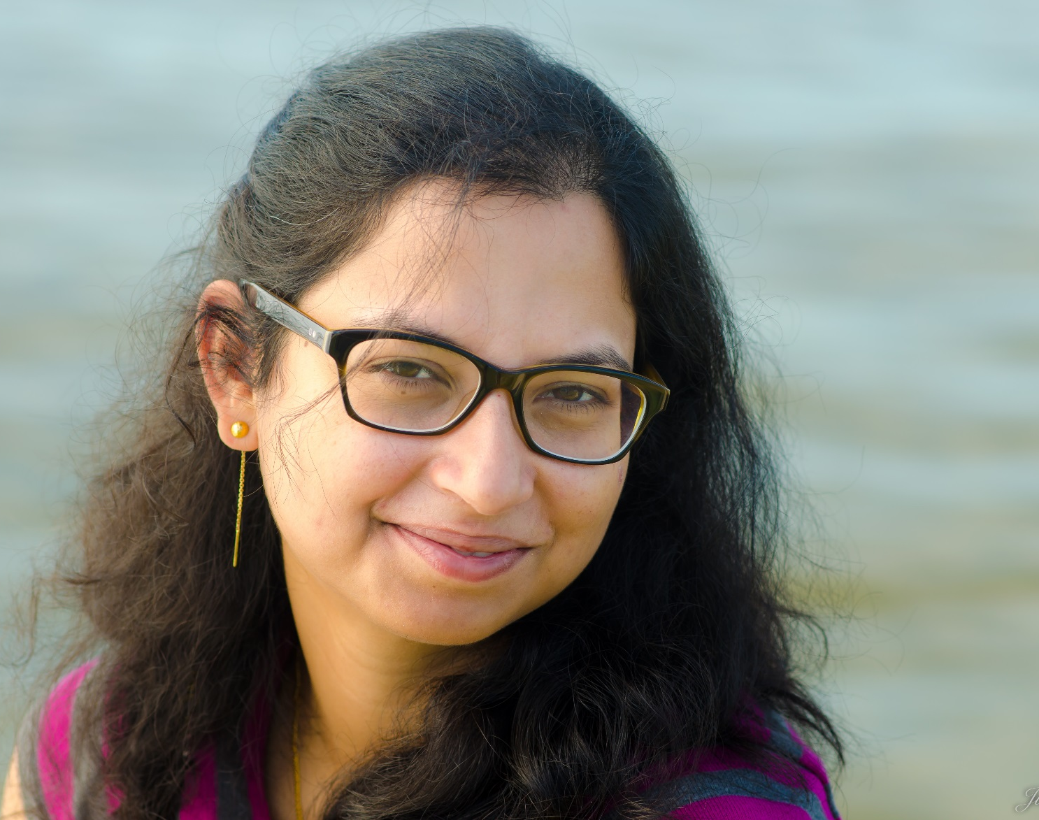
Nandini Guha
“logical mind, passionate heart and smile on lips”

Slide 57
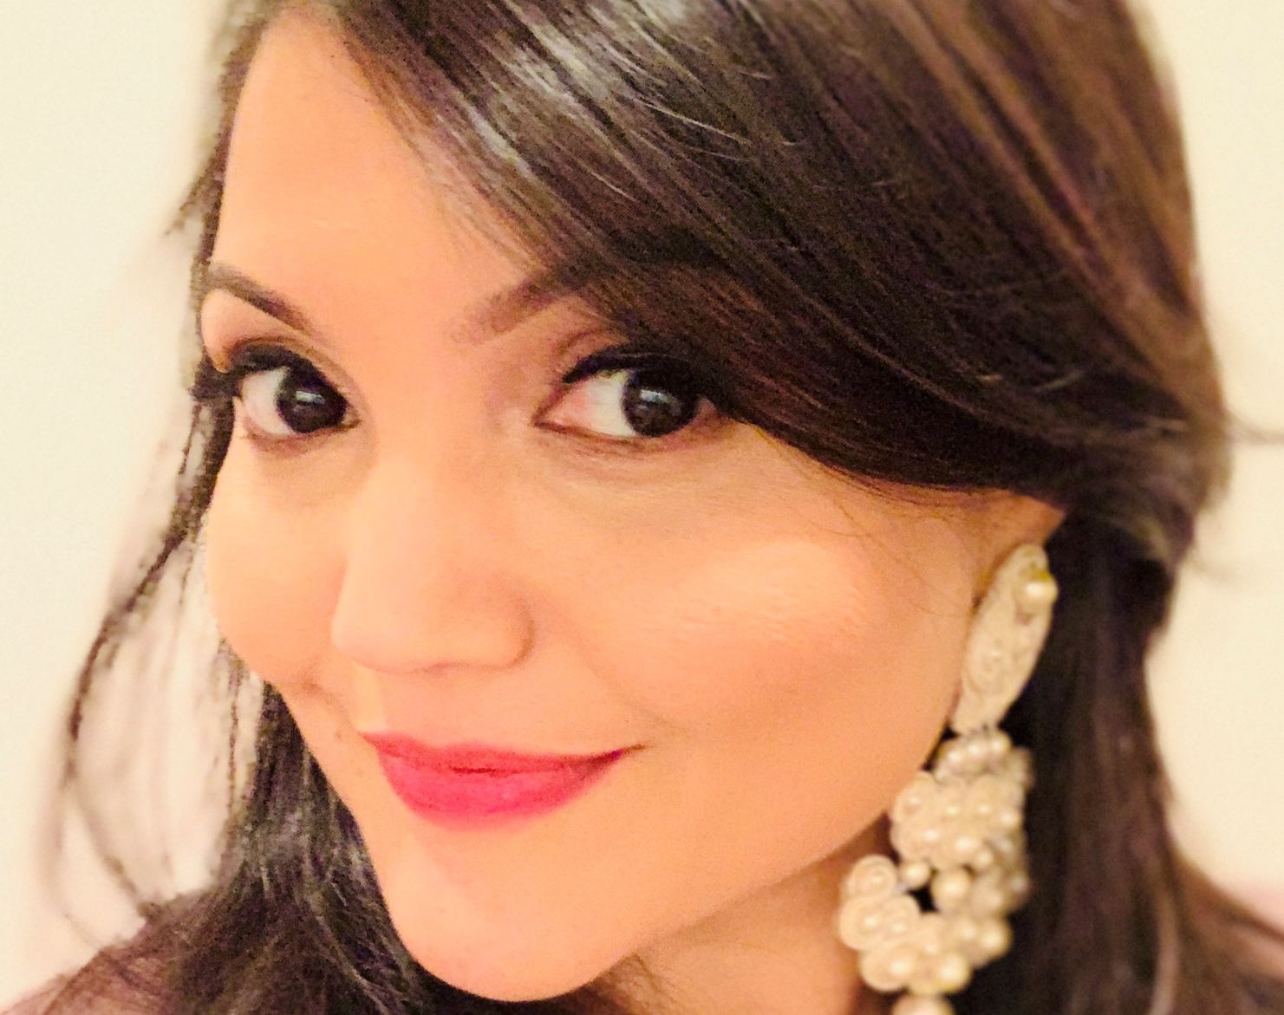
Supriya Jain Gupta
Never losing my free spirit and positive energy. Not having any regrets in life. My kids always being emotionally strong, happy and healthy. Making meaningful contributions in Pediatric Cardiology. Traveling the world with my family. My paintings displayed in Art galleries. Learning Kathak seriously. Starting a Children’s theater. Making documentaries. Fostering lasting friendships/relationships. Growing old gracefully with my husband.

Slide 58
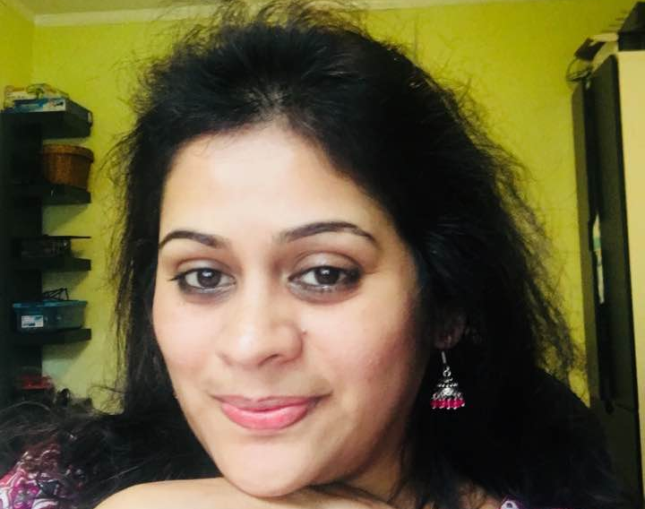
Shweta Pradhan
Dream-At this time I think of achieving all the hobbies which I always had and wanted to pursue but couldn't due to a very hectic engineering student. I have taken up learning Kathak dance which I always wanted to learn . I am very lucky to have Anindita as a teacher who is so passionate about teaching. Of course hitting the lottery and retiring ( very early) on a beach front is also one of them:) As they say,Never stop dreaming -for those who do most dream most .

Slide 59

Suchitra Joshi
I dream to travel the world and enjoy every nook and corner of this wonderful gift God has given us. The memories you create are indelible and people you meet on your journey are joy forever.

Slide 60

Sushma Khatke
Live in a peaceful gun-free world.

Slide 61

Kashmira Kuchibhatla
I dream of a world devoid of bitterness and hardship. I also dream of being able to touch someone's life such as to make a profound difference.

Slide 62

Vidhya Naidu
To smile and leave a smile, to travel and be enlightened, to inspire and be inspired, to be alive and let live, to care and be cared, to dream and make dreams come true, at the end of it all, leave beautiful memories to be cherished by all.

Slide 63

Siva Rasagnya Peddapalli
SAVE PLANET Only after the last tree has been cut down, only after the last river has been poisoned. Only after the last fish has been caught, only then will we find that money cannot be eaten. Consume less. Share better. My dream is to be an Environmental Activist

Slide 64

Ridhima Garg Saxena
The desire to pursue my passions and being able to live the life to its fullest had always been my dream. As they say the journey of life is filled with surprises, I found some of my dreams now connected to others. These are shared dreams which I have added on and one of them is to learn the Creative dance art forms. This to me is a way of expressing myself and attaining inner happiness.

Slide 65

Mala Srinivasan
Only when you drink from the river of silence shall you indeed sing. And when you have reached the mountain top, then you shall begin to climb. And when the earth shall claim your limbs, then shall you truly dance. Khalil Gibran

Slide 66

Vaishali Thiruvengadam
"More than dreams, want to fulfill my bucket list in this life time, like to travel around the world, want to experience skydiving, bungee jumping, roller skating and many more adventures. More than all want to be a student all the time, to be curious and keep learning.”

Slide 67

Sonia Varshney
I dream of finding myself in a state of fulfilment.

Slide 68

Jasna Vattoth
CPA by profession, mom of twin girls, wife, daughter and a sister, I started my venture "Threads New York" in 2018. Anindita reignited my passion for dance and helped me make some great friends for life. I dream of a life filled with friends, family, love , peace, music and dance.

Slide 69

Reecha Wadhwa
"I have a dream - to empower and inspire all women about "Self-care". Making healthy choices of diet, exercise, meditation, simply "being" and genuine connection with community. One woman at a time."

Slide 70
Team

Slide 71

Maya Srinivas
It starts with a dream, and mine is to be a better me.

Slide 72

Monali Ghosh
My dream and goal is to support the handcrafting communities and their talent and intricate work around the world. Monali g helps assist and creates jobs and opportunities among the women in these communities and empowers them. I draw inspiration from my travels and the different cultures around the world.
Monali G celebrates the rich traditions and craftsmanship of east combined with the western sensibility for the modern women.

Slide 73

Priya Nag
My dream is to use art to help people discover themselves, their culture and connect with the rest of the world, be it other human beings or nature.

Slide 74

Soma Vajpayee
“My dream is to see my art and work reach far corners in the world. I want to be remembered as a person “who inspires and is inspired”. I always want to celebrate the wanderlust in me - “All those who wander are not lost”.”

Slide 75

Anindita Ganguly
My goal is to not only teach students the technical aspects of dance, but also build self-confidence, and exercise the brain and body through dance. I would like to create an organization dedicated to increasing the awareness of dance as a therapy for neurodegenerative diseases.

Slide 76


